Slide 1



How to Access
Your Child’s
Gradebook

Slide 2

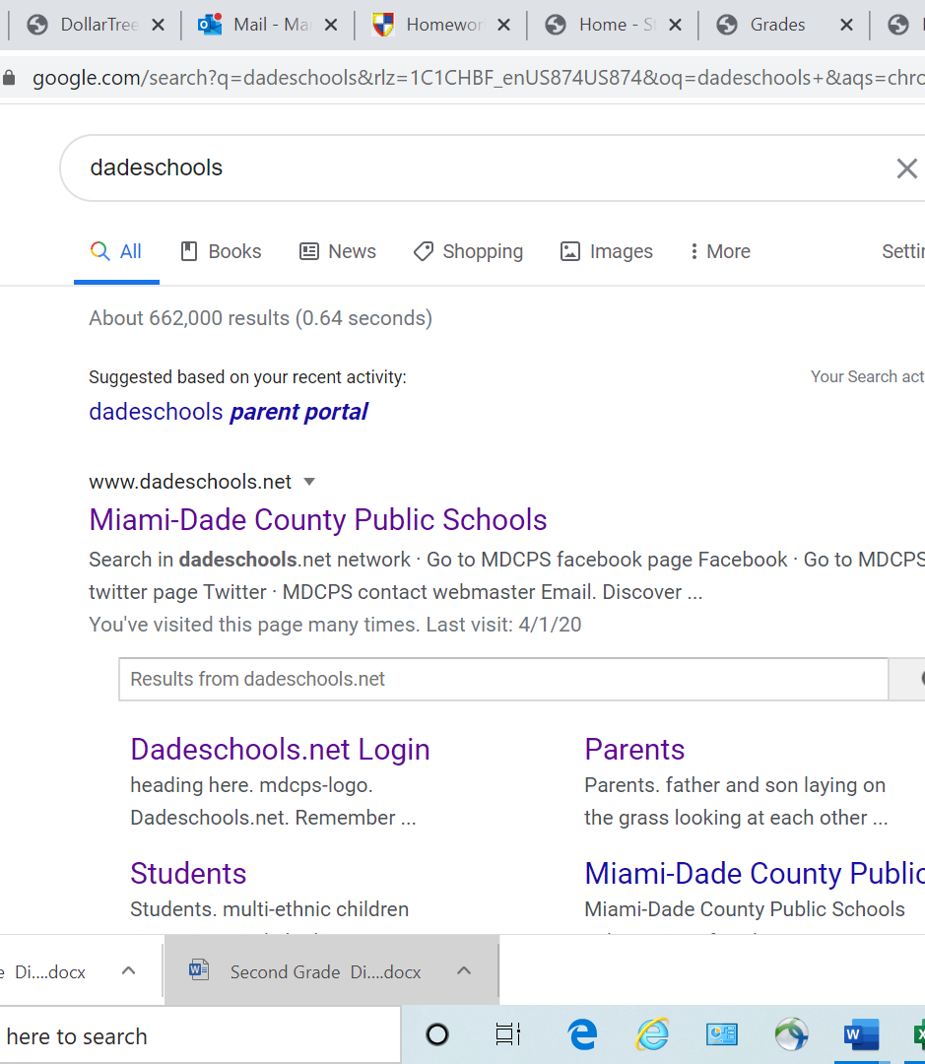
Website
First, start by typing http://www.dadeschools.net/
into the address bar or click the link above.

Slide 3

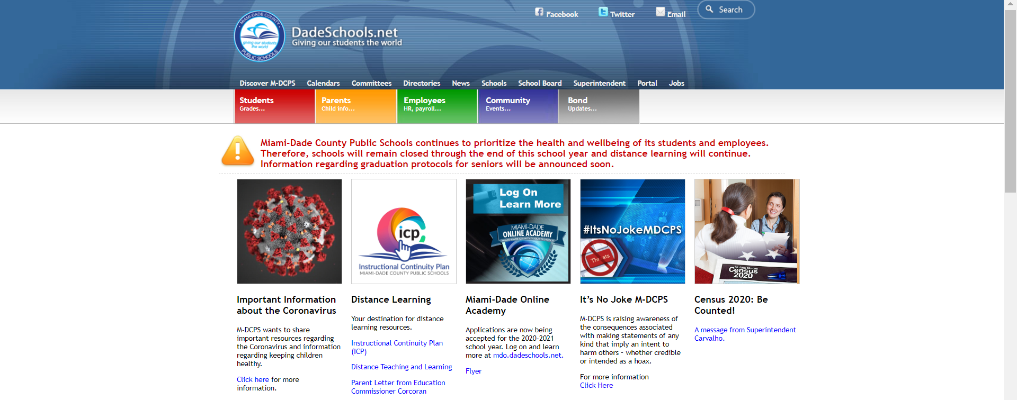
Once accessing the portal, click the red “Students” box shown above.

Slide 4

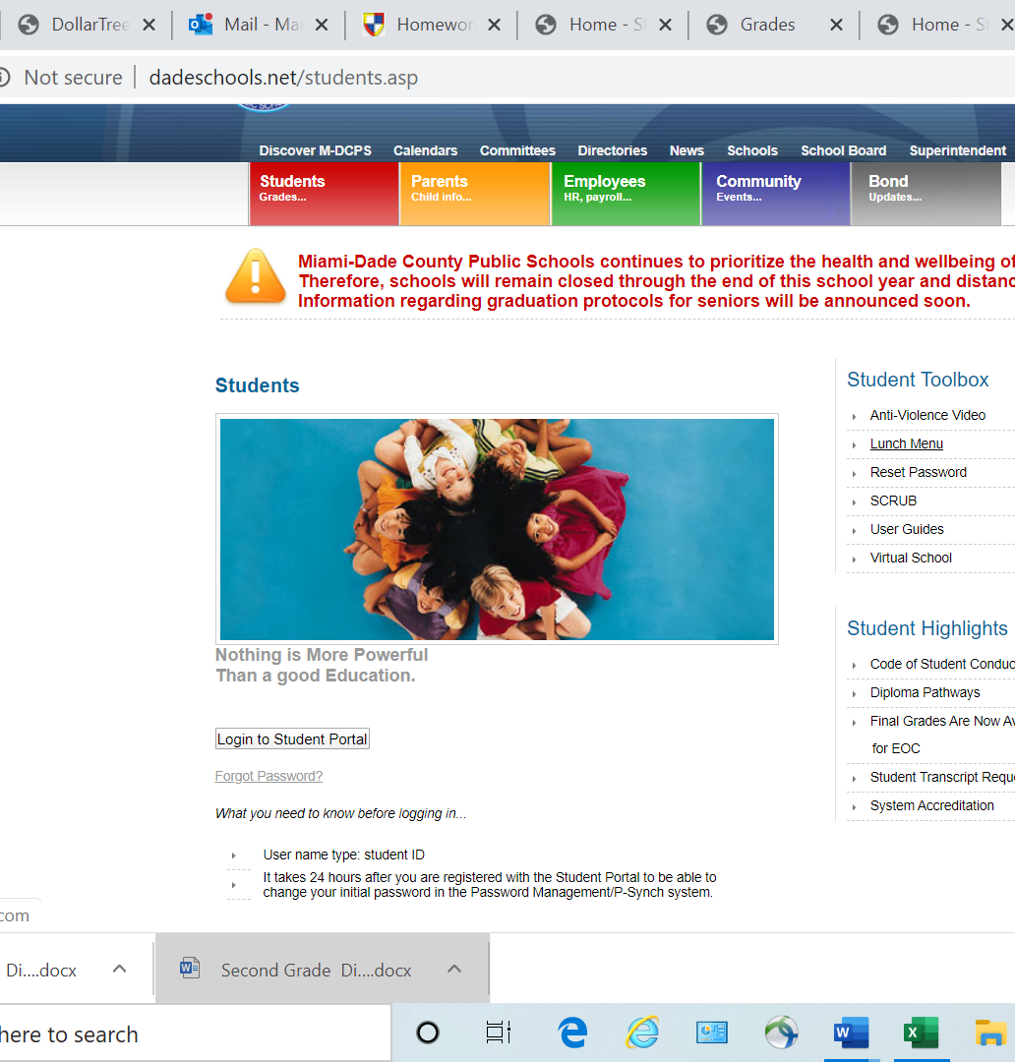
Logging In
Now click the “Login into Students Portal” button.

Slide 5
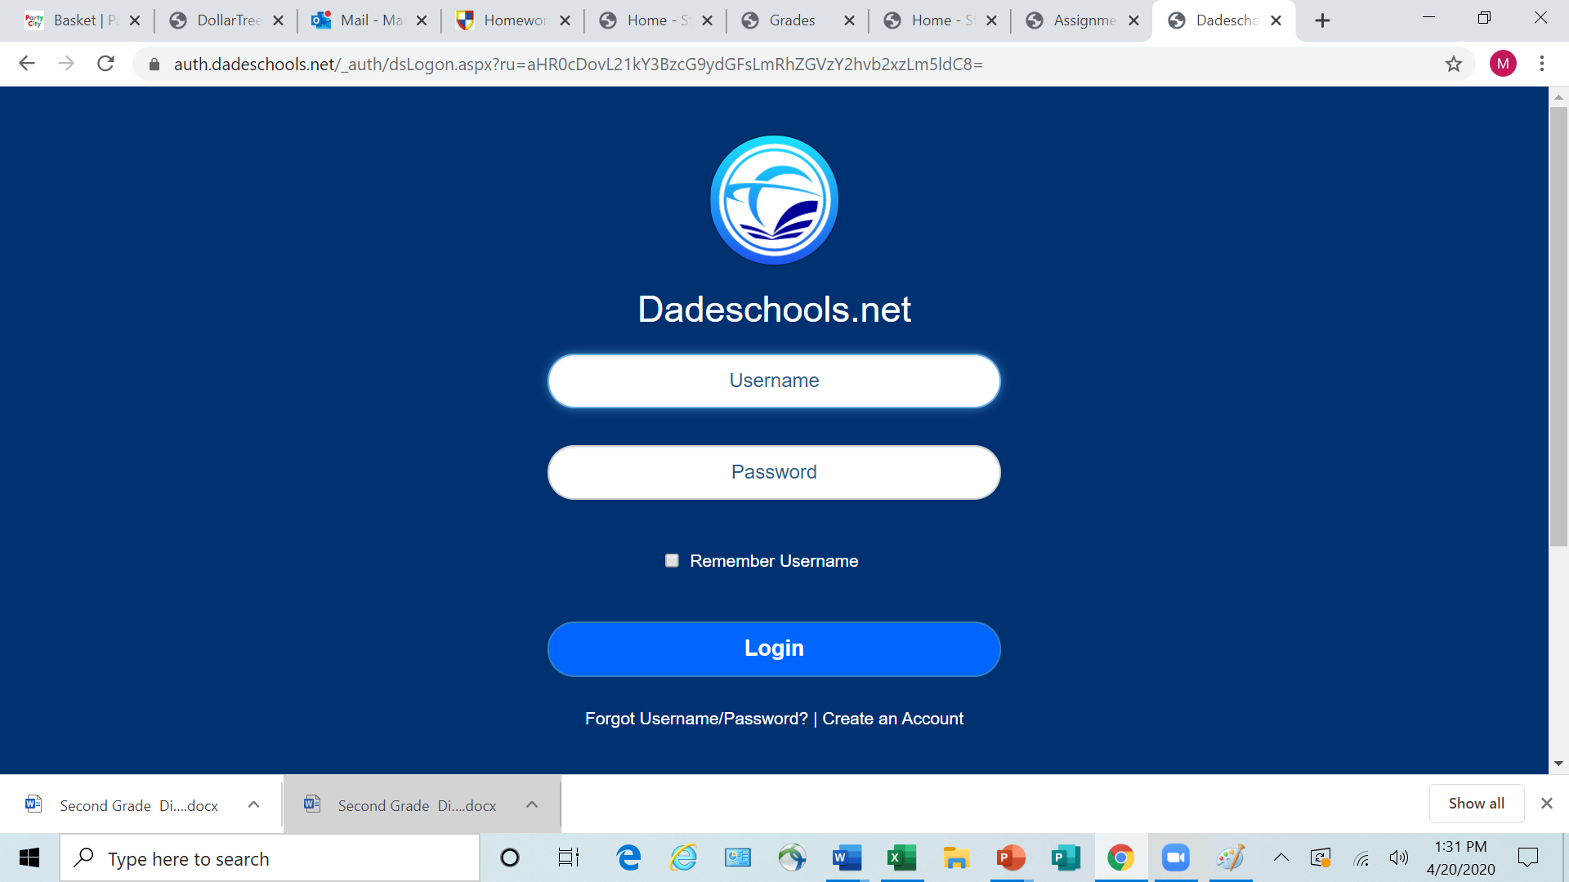
Enter your child’s username and password
- The username will be your child’s ID number. *If you don’t know your username/ID number, please reach out to your child’s teacher or call the Main Office.
- The password will be your child's birthday and their first and last initial. If your child’s birthday is November 15, 20011 and his name is Harold Martinez, his password would be 11/15/11HM.
(If the website asks you for a pin-your child’s teacher or Main Office can provide this for you.)

Slide 6
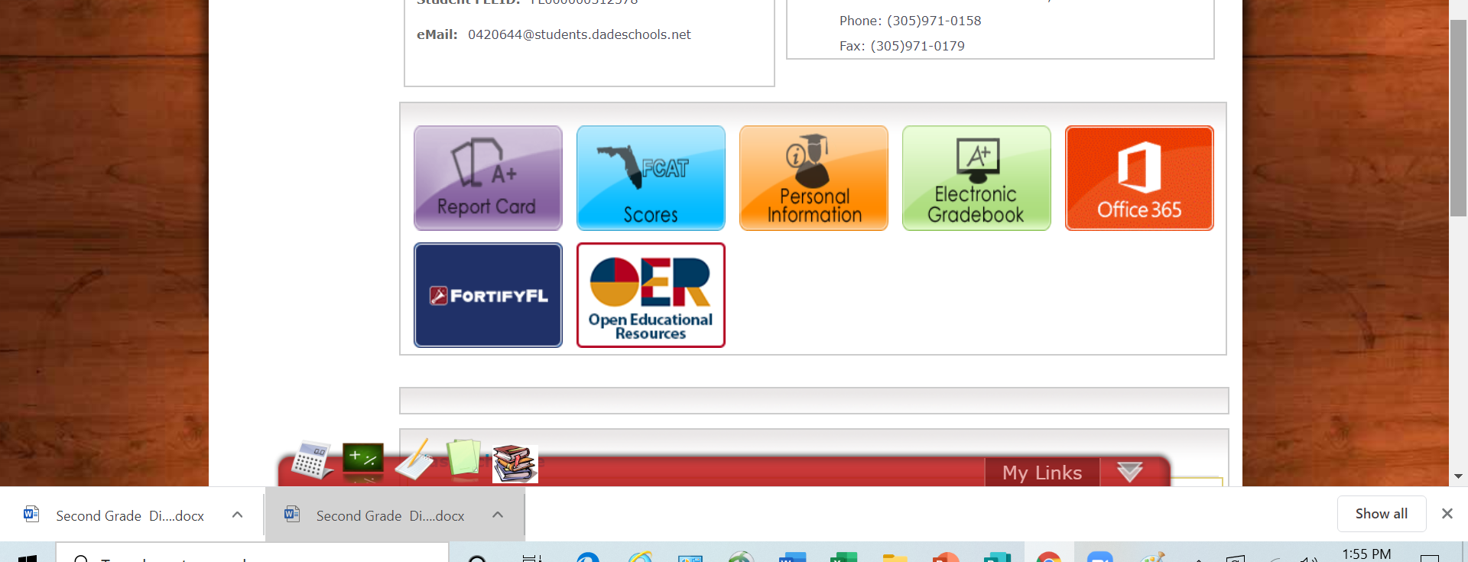

To access your child's grades, scroll to the bottom and click the green “Electronic Gradebook” button.

Slide 7
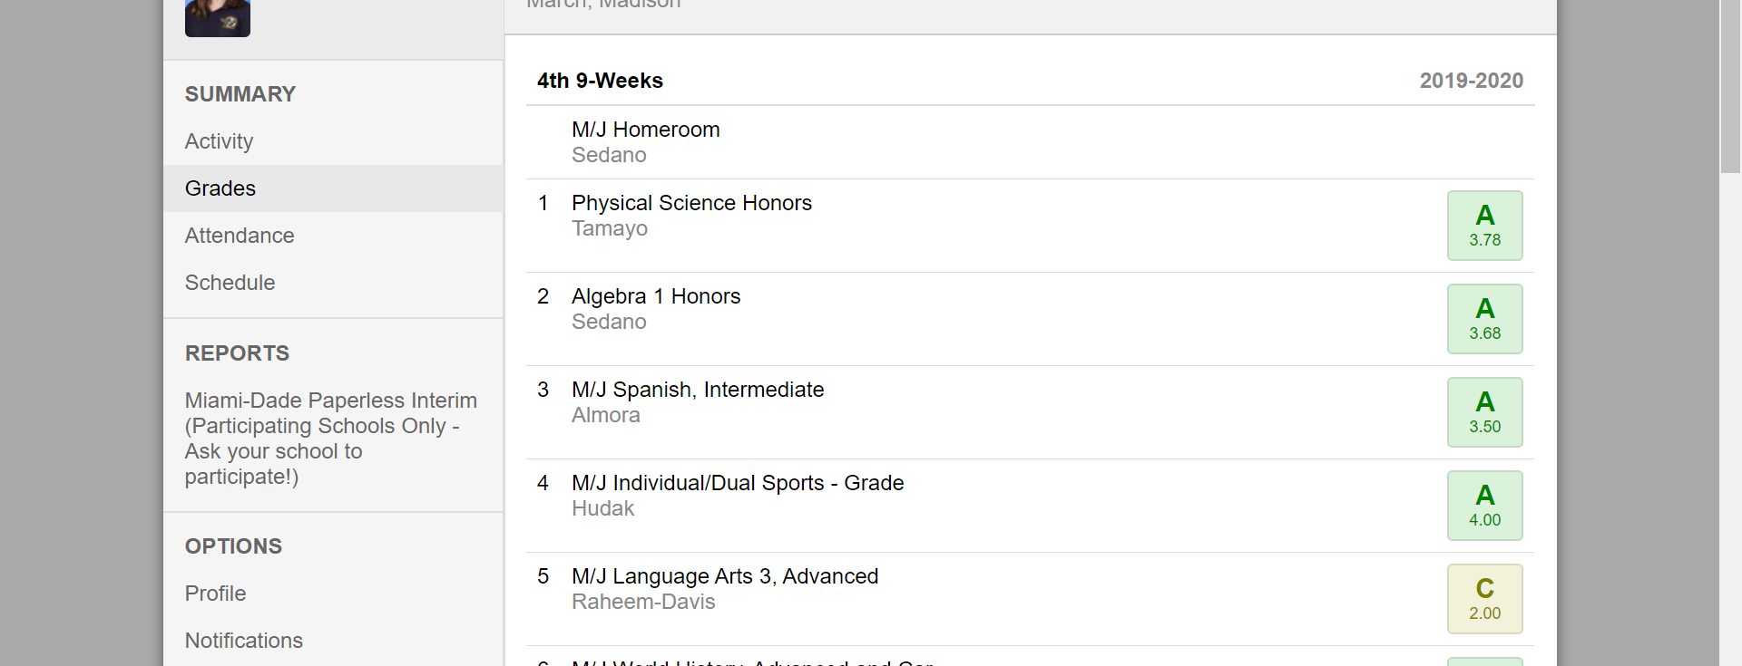


Once you open your gradebook you can also see your child’s attendance and schedule which is located on the left-hand side.

Slide 8
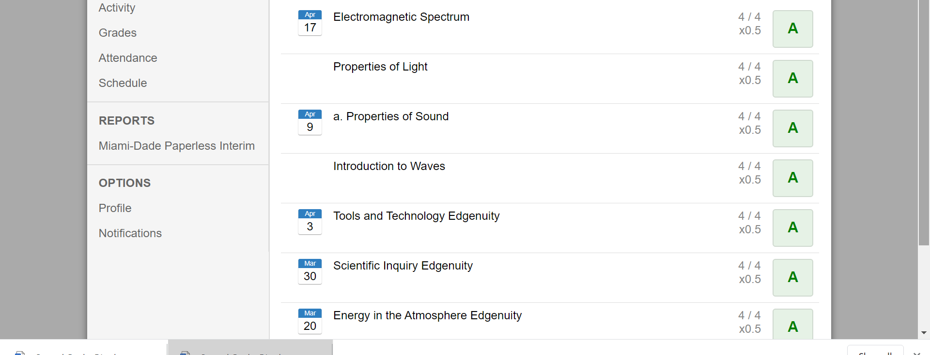
To view your child’s specific assignment grades click on the grade for the subject you would like to view and all assignments and grades earned will populate.

Slide 9
If you have any questions, please feel free to contact your child’s teacher or our Main Office at
(786) 300-4980.
We are here to help!

